Slide 2
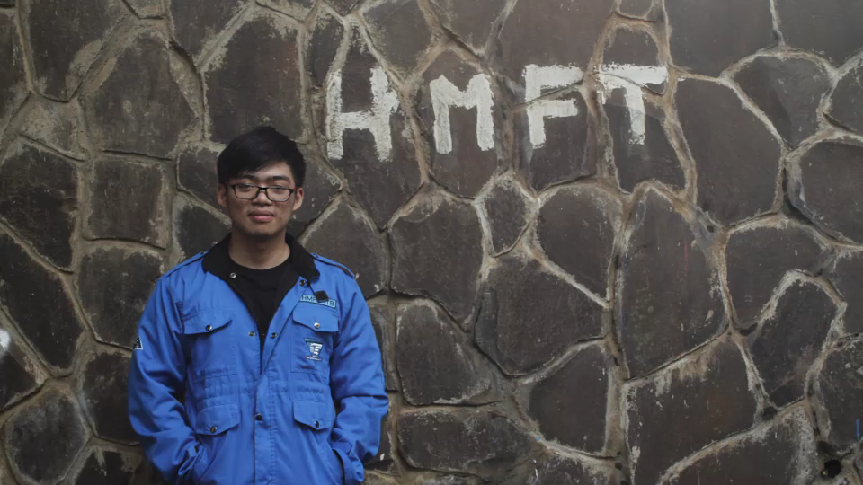

Slide 3







INDONESIA
BANDUNG
LARGEST CITY
LARGEST WORLD
CO₂
CO₂
EMITTER
EMITTER
0.9 °C
0.9 °C
_{TEMPERATURE INCREASE}
per
30 years
_{TEMPERATURE INCREASE}
per
10 years

Slide 4

ITB
?
HOW
ABOUT

Slide 5




ITB FACT
PARKING AREA
TOTAL CAPACITY
4137
INSIDE CAMPUS
1209
878
Smart card user
3600
WEST PARKING
1100
0
MAXIMUM VEHICLES
5650
OVERLOAD
8,6%
PASTEUR TOLL
PER DAY
0,5%
BANDUNG
VEHICLE
(1.406.432)
EAST PARKING
900
50

Slide 6

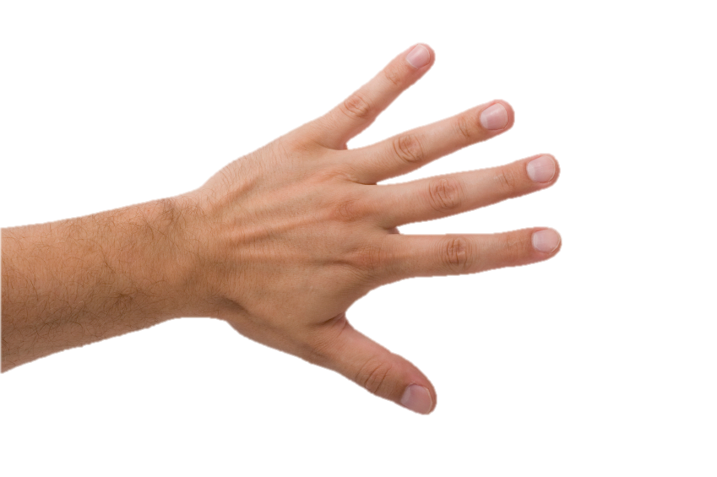
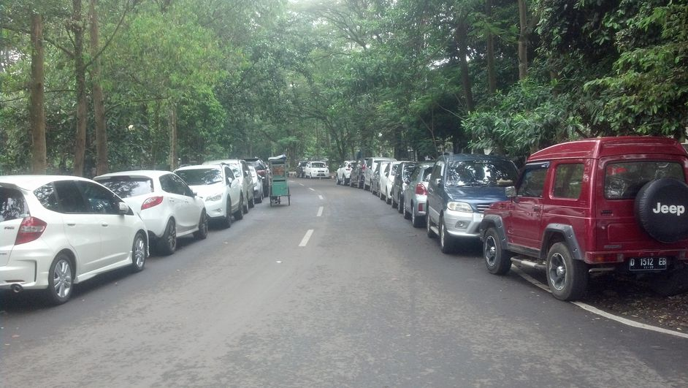
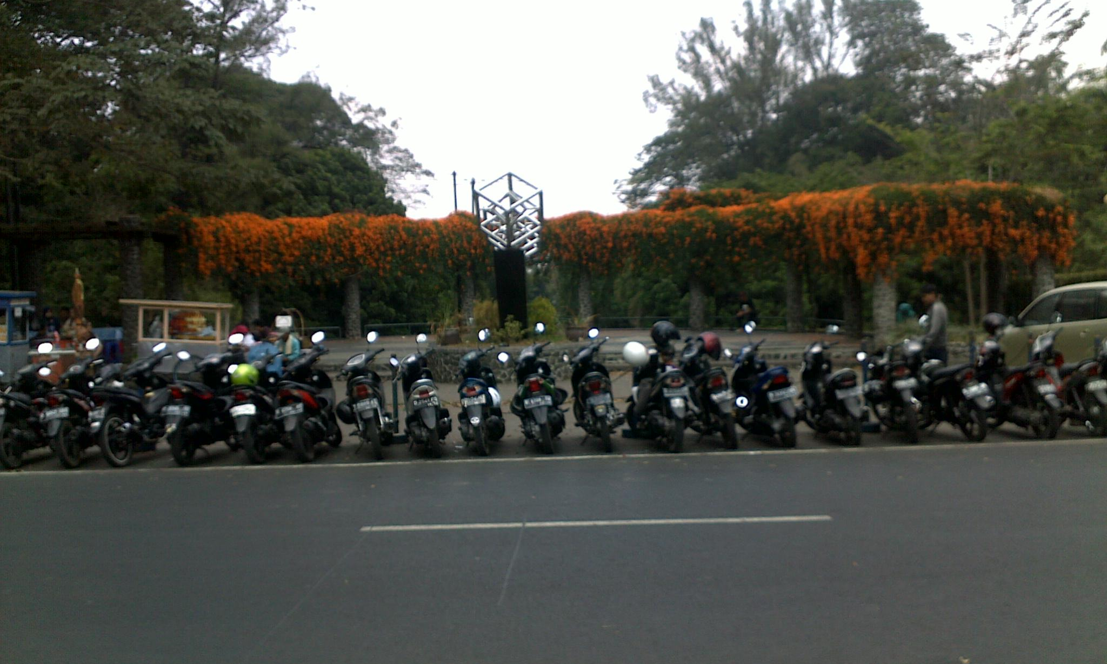
CARBON IN ITB?
INDONESIA NATIONAL STANDARD (SNI) 2002/51/EC
CO
2,62 g/km
CO₂
120 g/km
V average = 1,6 L
2,5% v/v
2,5% v/v
Total Vehicle in 1 year = 1.560.200 Vehicles
OUTSIDE CAMPUS?
Total Carbon = 594,6962 kg
= 0,6 ton /year carbon emission
62%
0,125%
INSIDE CAMPUS →
PARKING CONTRIBUTE
→
CAMPUS
CARBON EMISSION
BANDUNG
CARBON EMISSION

Slide 7

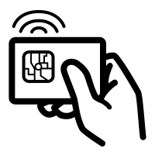

EXISTING SOLUTION
SMART CARD
BICYCLE

Slide 8
problems?

Slide 9








SMART
CARD
BICYCLE
STATION
DEPENDENCY
STEEP CONTOUR
INSUFFICIENT LUGGAGE
LIMITED ACCESS
TIME CONSUMING
ABANDONED
BIKES
ELDERLY
SAFETY

Slide 10
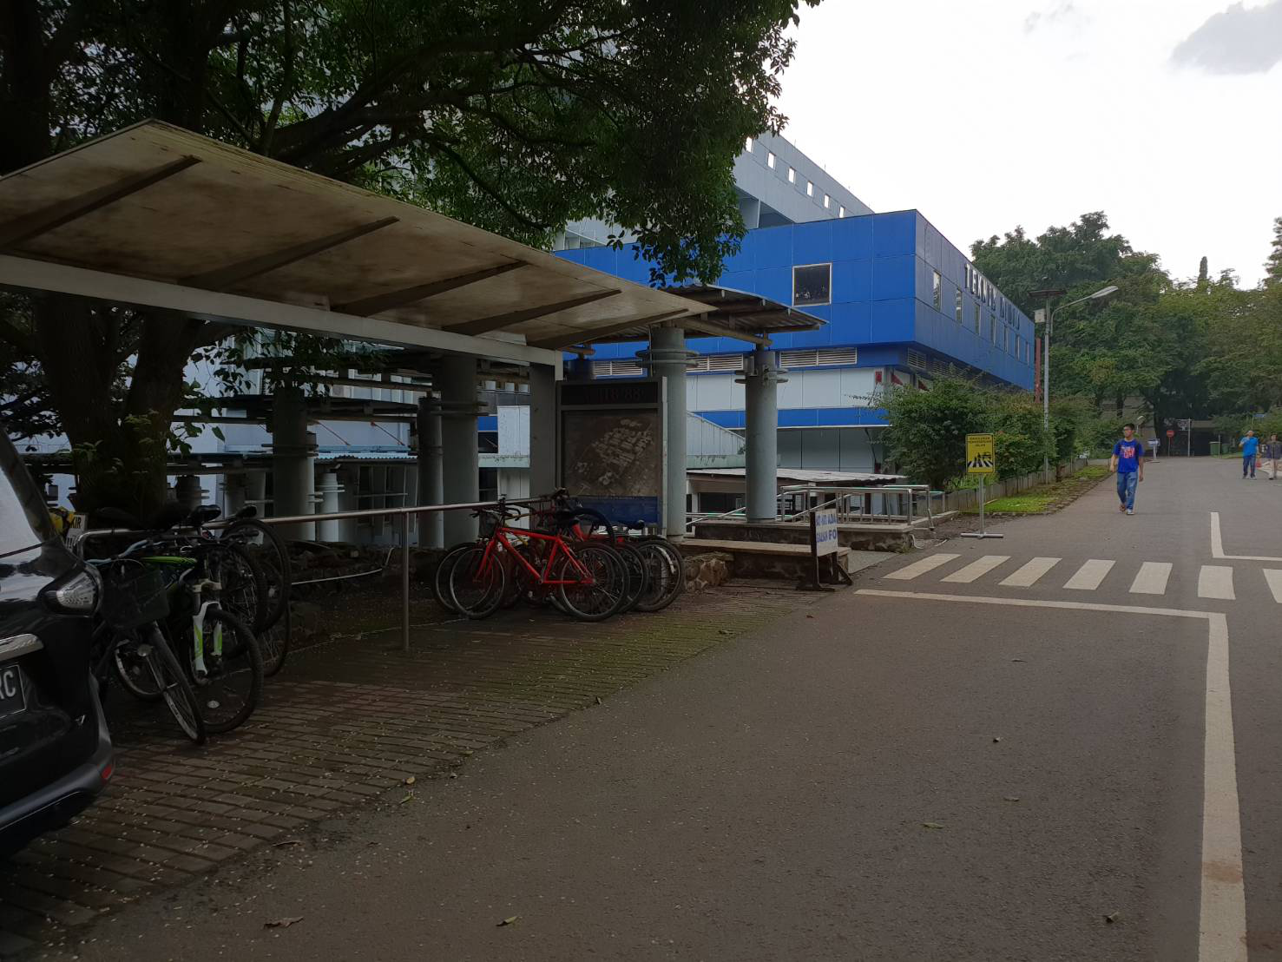
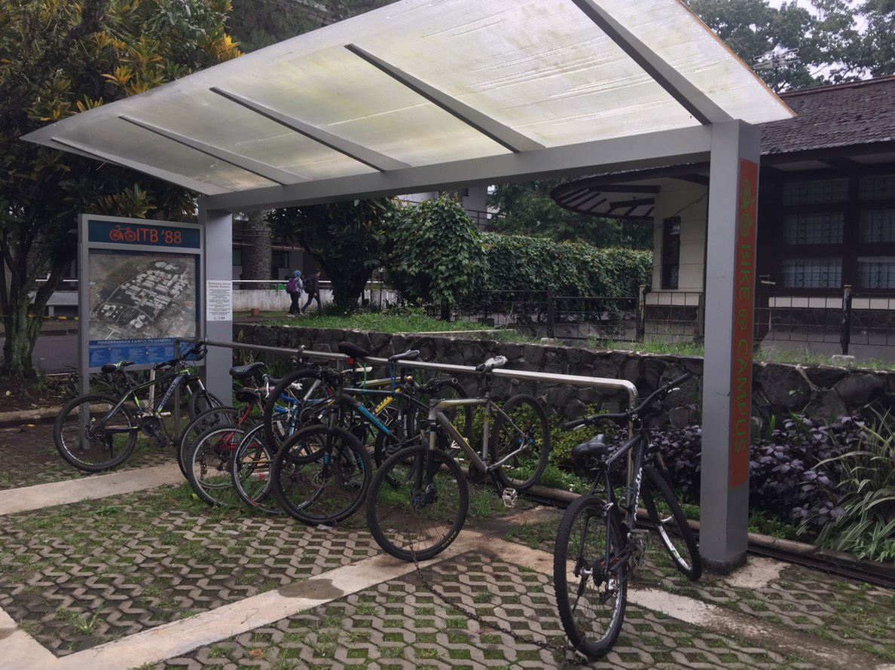
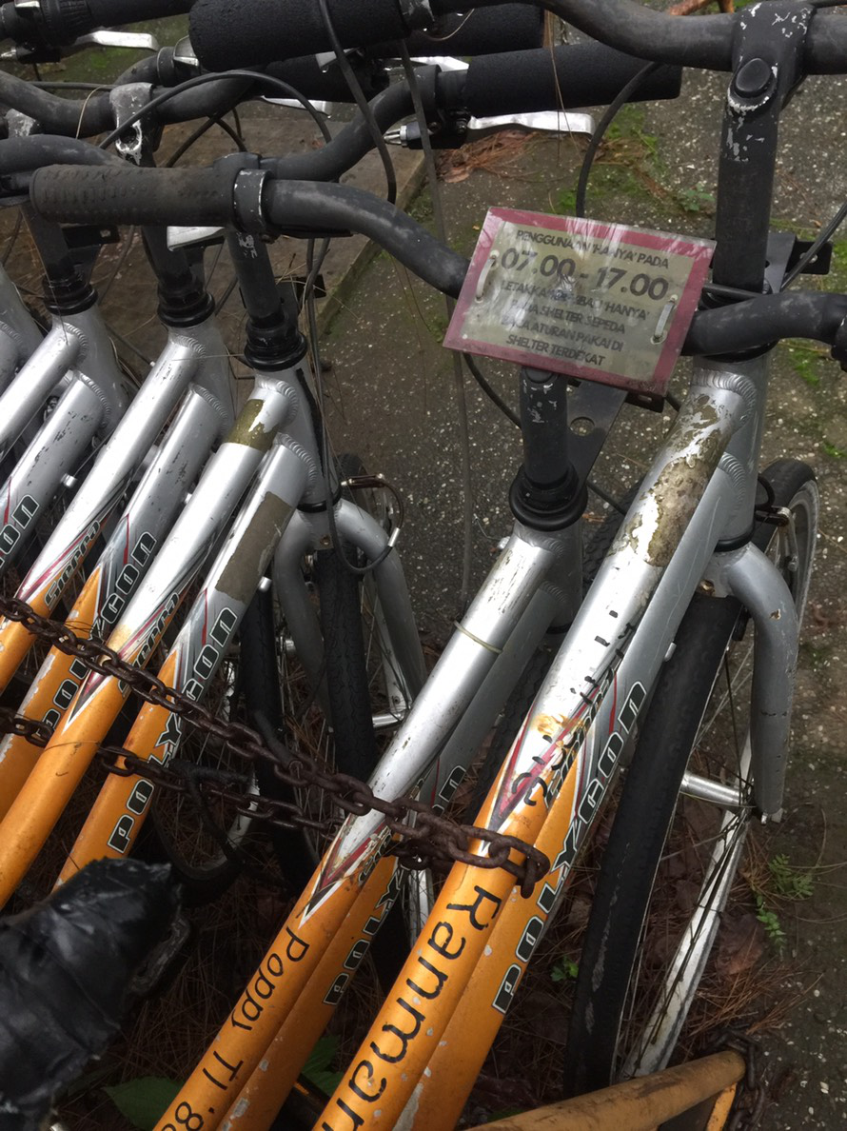
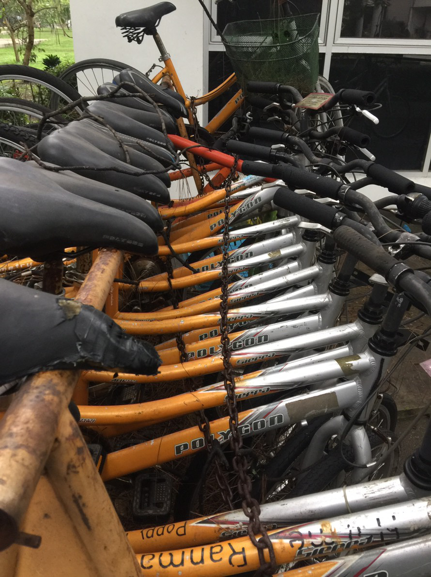

Slide 11









WE have an idea
Time saving
safety
independency
REAL ACTION
&
FUTURISTIC WAY
Unlimited access
capacity

Slide 12

VIDEO RENDY

Slide 13



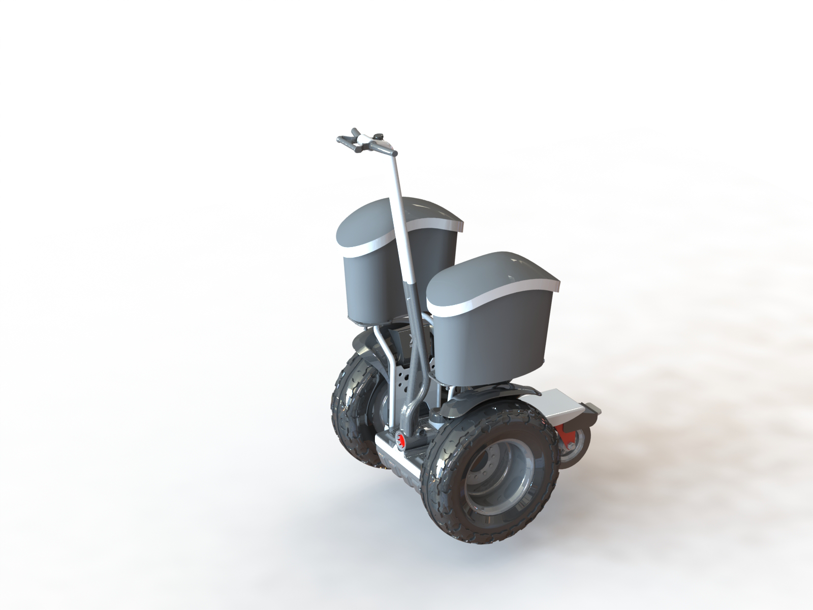
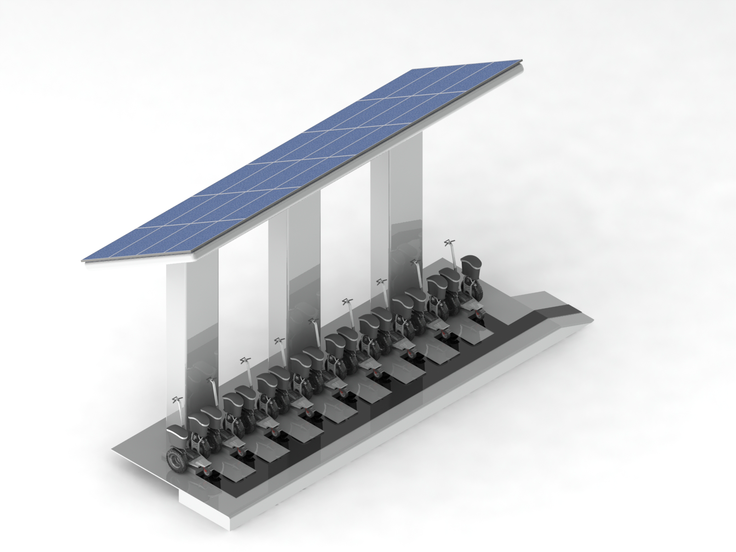




NO FOSSIL FUELS
RENEWABLE
LESS CARBON
station
EASY TO USE
SUITABLE FOR ALL USERS
ICARUS
AUTODRIVE
LESS WAITING
FASTEST ROUTE
LARGE CAPACITY
ACCURACY

Slide 14






ORDER
AUTO DRIVE
RETURN TO STATION
SELF DISTRIBUTION

Slide 15


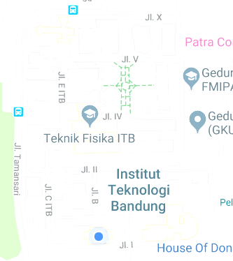





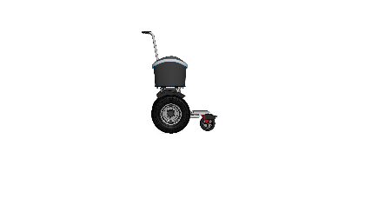




25
4
HIGH DEMAND
RETURN TO STATION
10
8
7
night time redistribution

Slide 16

INVESTMENT
ANALYSIS

Slide 17
SEGWAY IDR 4.319.000/ unit
50 units
STATION IDR 15.000.000/ station
5 stations

Slide 18
VEHICLE INSIDE ITB
878
1209
Oil Price
IDR 7800/ litre

Slide 19
IRR (Internal
Rate of Return )
18.57%
BEP
(Break Even Point)
3.09 Years

Slide 20






CONCLUSION
OPPORTUNITY
REDUCE CARBON EMISSION IN ITB
ITB
BRANDING
SUSTAINABLE
TECHNOLOGY
CONTRIBUTION FOR
WORLDWIDE ENVIRONMENT
MORE PUBLIC TRANSPORTATION

Slide 21

WHO SPEAKS IN WORDS, BUILDS HIMSELF WHO SPEAKS IN ACTION, BUILDS THE WORLD

Slide 22


THANK YOU (video alfi)

